Slide 1



HEART RATE DETECTOR
Team No: 8
Team Name: United Hearts
Presented by:
Suman - 22R21A67D5
Tanuja - 22R21A67F7
Abhishek - 22R21A67F3
Sravan - 22R21A67D7

Slide 2

Problem Statement
Loss of lives in the absence of supervision during heart attack.

Slide 3
Customer Survey
Doctors said that in most of the cases people are being late to hospital and loosing their life.
He said that our device would definitely help patients to get medications in time.

Slide 4
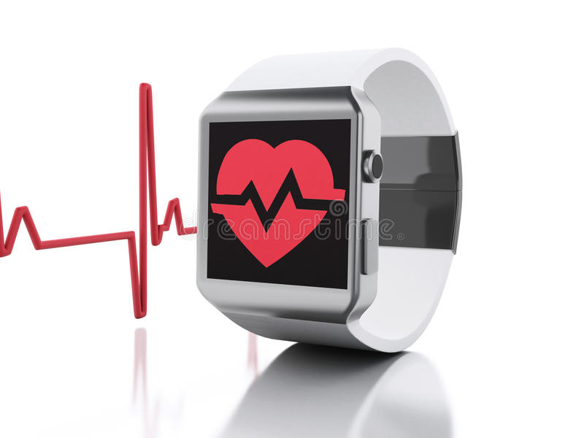
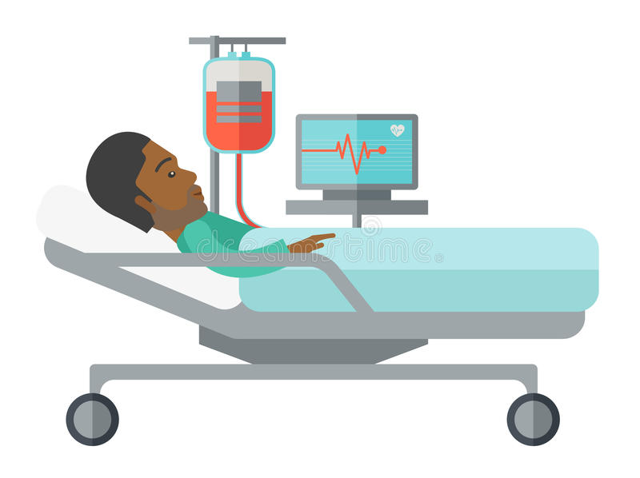
Existing Solutions
There are devices which can only monitor heart rate of the patients.
These are mostly used in hospitals and in smart watches too.
These can only monitor the heart rate of the patients but it should also provide some safety.
IoT Hackathon 2019

Slide 5

Our Solution
Our product “Heart Rate Detector” can detect the heart rate and send an alert to the hospital and also send a message to family and friends when the heart rate goes abnormal.
Shares current gps location with the ambulance

Slide 6
Value Proposition
Unlike other solutions ,our device can monitor heart rate of the patients.
Send alert to family and hospital which is not done by the existing solution.
Shares current GPS location with the ambulance in their helpless condition during cardiac arrest.

Slide 7


Customers & Consumers
Heart patients, drivers, passengers and other patients suffering with different problems like asthma would be our consumers.
Our customers would be health industries ,electronic stores and e-commerce websites.

Slide 8
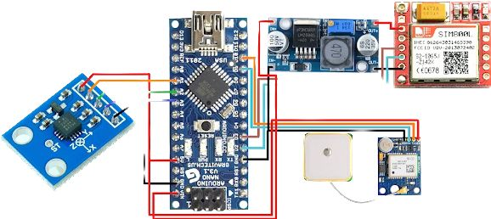
Design – Blueprint
A smart band that can detect our pulse rate and can send an alert to family and hospital during cardiac arrest and shares our current GPS location to the nearby hospital.
We would add temperature detector and also oxygen percentage check.
We would also try to add all the smart watch features to it.
IoT Hackathon 2019

Slide 9
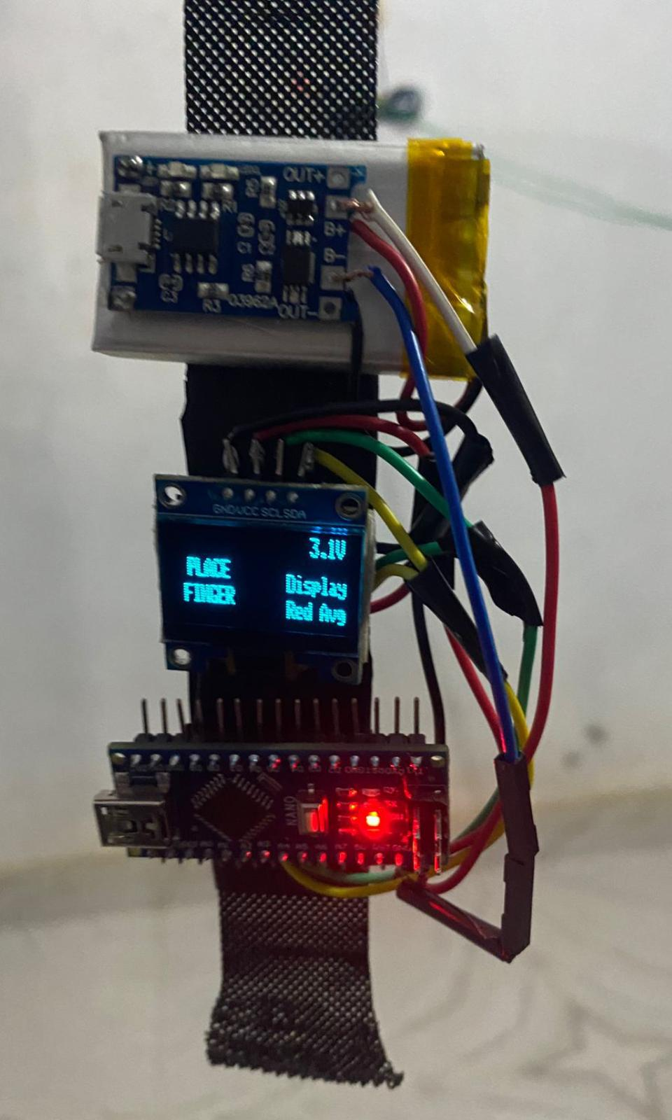
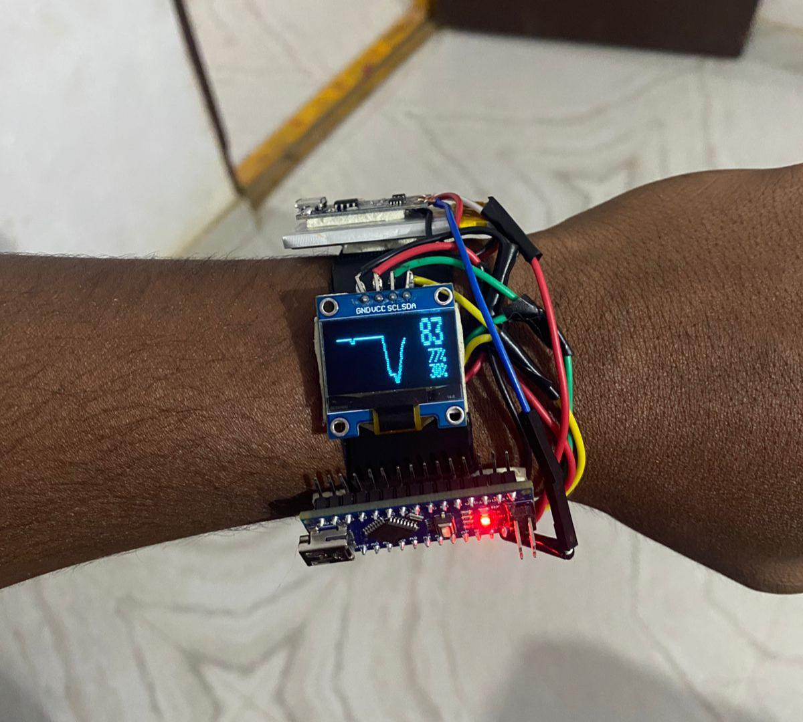
Output
IoT Hackathon 2019

Slide 10

IoT Hackathon 2019

